Slide 1


Efficient Non-Sampling Factorization Machines for Optimal Context-Aware Recommendation
Chong Chen
Department of Computer Science and Technology,
Tsinghua University
Notes:
Hello everyone, my name is Chong Chen and I’m from Tsinghua University. I’m honor to be here to make my presentation. The topic of my paper is Efficient Non-Sampling Factorization Machines for Optimal Context-Aware Recommendation

Slide 2
Background (1): Users’ Sparse Feedback Information
RecSys has become a major monetization tool for customer-oriented online services
E.g., E-commerce, News Portal, Social Networks, etc.
Users usually rate or click a small set of items compared to hundreds of millions of items in the system
“Negative Information” in implicit feedback
Notes:
With increasing number of choices available online, recommender systems are playing a more and more important role in alleviating information overload, and have been widely adopted by many websites and applications.
In recommender systems,the most widely used user feedback is implicit data,such as the logs of views, clicks, and purchases. The implicit data is usually sparse and only contains positive instances, which makes it hard to be utilized for learning a recommender system.
To leverage implicit data, a commonly used learning strategy is called “negative sampling ”, which samples negative instances from non-labled data. However, it is not robust as sampling may lost important information and usually leads to non-optimal performances in practical.

Slide 3
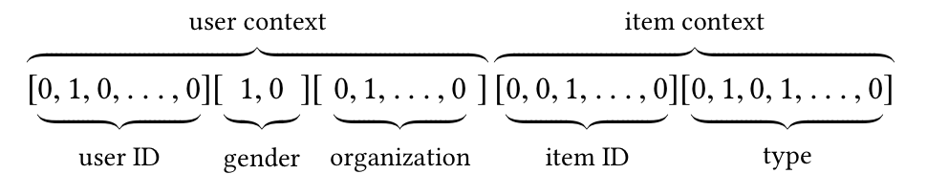
Background (2): Context-aware Recommendation
Leveraging contextual information
User demographics, item attributes, and time/location of the current transaction, etc.
Factorization Machines (FM) with negative sampling is a popular solution for context-aware Top-N recommendation
Notes:
On the other hand,
To provide more accurate recommendation, it is a trending topic to go beyond modeling user-item interactions and take context features into account.
Context-aware recommender systems exploit contextual information such as user profiles, item attributes, and other useful information.
To learn from such context-rich data, several effective models have been proposed, among which Factorization Machines (FM) gains significant attention from researchers.
Factorization Machines (FM) with negative sampling is a popular solution for context-aware recommendation.
Next I will make a brief introduction about the recent studies on Factorization machines.

Slide 4
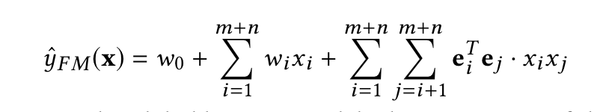
Preliminaries: Factorization Machines
FM[Rendel et al.,ICDM2010] is one of the most effective context-aware recommendation algorithms
One/Multi-hot feature vectors as inputs
Feature crossing
Notes:
Factorization machines \cite{rendle2010factorization} is a generic framework which integrates the advantages of flexible feature engineering and high-accuracy prediction of latent factor models. Given a real valued feature vector \textbf{x}, FM estimates the target by modelling all interactions between each pair of features via factorized interaction parameters:

Slide 5
Preliminaries: Factorization Machines
Applying deep neural networks for modelling high-order feature interactions
Multi-layer perception (MLP), NFM, DeepFM, etc.
Attention mechanisms, AFM, etc.
Convolutional Neural Network (CNN), xDeepFM, CFM, etc.
Existing FM studies either focus on rating prediction task only, or typically adopt convenient negative sampling for optimizing the ranking performance
Notes:
With the development of deep learning. many variants of FM have been proposed, such as DeepFM [15], NFM [16], AFM [43], xDeepFM [25], and CFM [44], etc.
Despite the overwhelming research on FM, the majority of existing studies are conducted to apply deep neural networks for modelling high-order feature interactions, such as multi-layer perception (MLP) \cite{guo2017deepfm,he2017neural2}, attention mechanisms \cite{xiao2017attentional}, and Convolutional Neural Network (CNN) \cite{lian2018xdeepfm,xincfm}, etc. However, these studies either focus on rating prediction task only, or typically adopt convenient negative sampling for optimizing the ranking performance. Although these methods have yielded great promise in many prediction tasks, their ranking performance are limited by the inherent weakness of sampling-based learning strategy.

Slide 6
Motivation: Progresses and limitations in Neural Rec. Models
✓✓ Exploring new deep learning architectures for Rec. Sys.
Attention, MLP, CNN, etc
Superior ability to complex network structures
✓✓ With substantial number of parameters
✓✓ Require expensive computations even with a sampling-based learning strategy (negative sampling)
Complex Neural Network
Can we find some solutions to efficiently learn a neural recommendation model with the help of contextual
information without sampling?
Negative Sampling
✓✓ Not robust
✓✓ Difficult to achieve the optimal performance in practical applications
Notes:
Ok lets see the motivation of our study.
Despite effectiveness, we argue that existing deep learning based recommendation methods suffer from two important limitations: First, the methods with complex network structures have a substantial number of parameters, and require expensive computations even with a sampling-based learning strategy; Second, as shown in previous work [23, 53], the performance of negative sampling is not robust as it is highly sensitive to the sampling distribution and the number of negative samples. Essentially, sampling is biased, making it difficult to achieve the optimal performance in practical applications.
In contrast to sampling, non-sampling strategy computes the gradient over the whole data (including all missing data). As such, it can easily converge to a better optimum in a more stable way.
To address the above limitations,one important question arise: Can we find some solutions to efficiently learn a FM model without sampling?

Slide 7
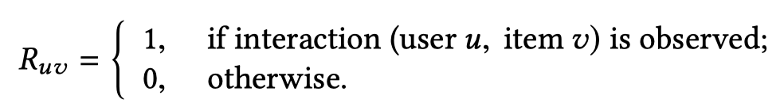
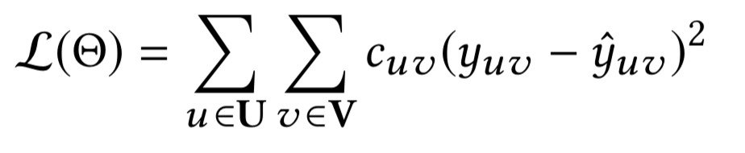
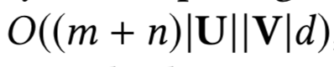
Complexity Issue of Non-sampling FM
In implicit data, the user-item interactions R is defined as:
For a commonly-used non-sampling loss:
Complexity:
Number of context features
Notes:
the difficulty in applying non-sampling strategy lies in the expensive computational cost. For implicit data, the observed interactions are rather limited, and non-observed examples are of a much larger scale. A commonly used non-sampling loss is as follows [22], which associates a confidence to each prediction in the implicit feedback matrix。
For this loss, the whole complexity of computing the loss is generally unaffordable — O((m + n)|U||V|d), because |U||V| can easily reach billion level or even higher in real life.

Slide 8
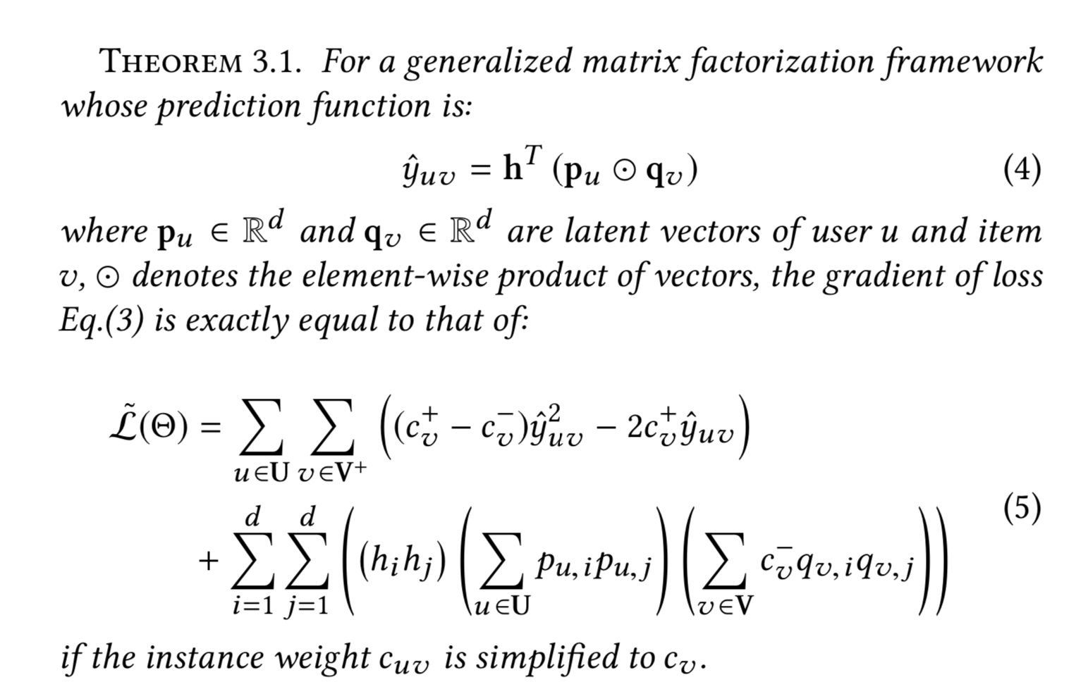
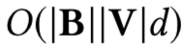
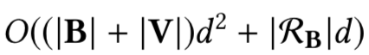
Efficient Non-sampling Matrix Factorization
#Hidden
#Users
#Items
#Positive
Chen et al. Efficient Neural Matrix Factorization without Sampling for Recommendation. (TOIS Vol. 38, No. 2, Article 14)
Notes:
To address the inefficiency issue of non-sampling learning, several methods have been studied. In previous work, also our work, we have derived an efficient loss for Matrix Factorization, and proved,
As we can see on the right part, The complexity of the new loss reduced by several magnitudes. The proof of this theorem can be made by reformulating the expensive loss over all negative instances using a partition and a decouple operation, you can find the detailed proof in our previous paper.

Slide 9
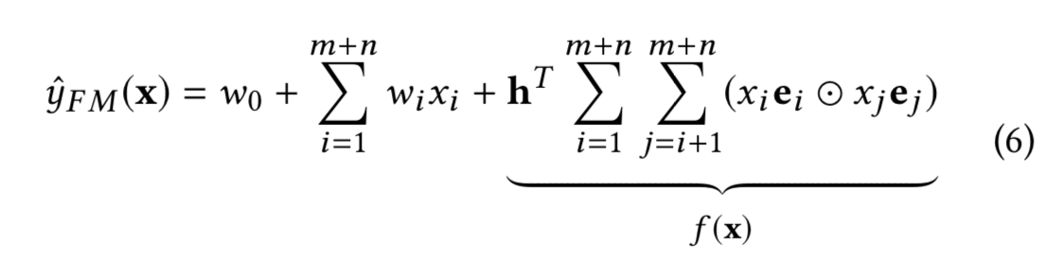
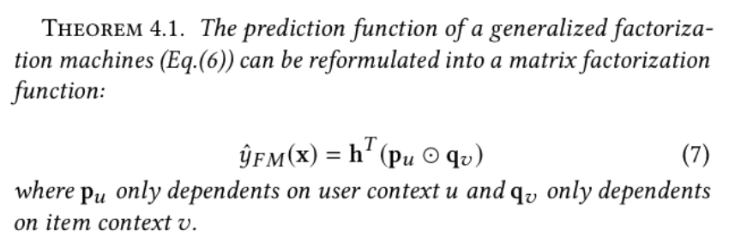
Efficient Non-sampling Factorization Machines （ENSFM）
https://github.com/chenchongthu/ENSFM
https://github.com/THUIR/ENSFM
Notes:
Back to this paper, different from previous work, we propose to efficiently learn FM models without negative sampling
This figure shows the general framework of our model. The prediction function of ENSFM follows the generalized embedding-based FM,
Through novel designs of memorization strategies, we first reformulate FM into a generalized MF framework, and then leverages the bi-linear structure of MF to achieve speedups.
We present the theoretical guarantee of our proposed Efficient Non-Sampling Factorization Machines: which is:
添加一个layer

Slide 10
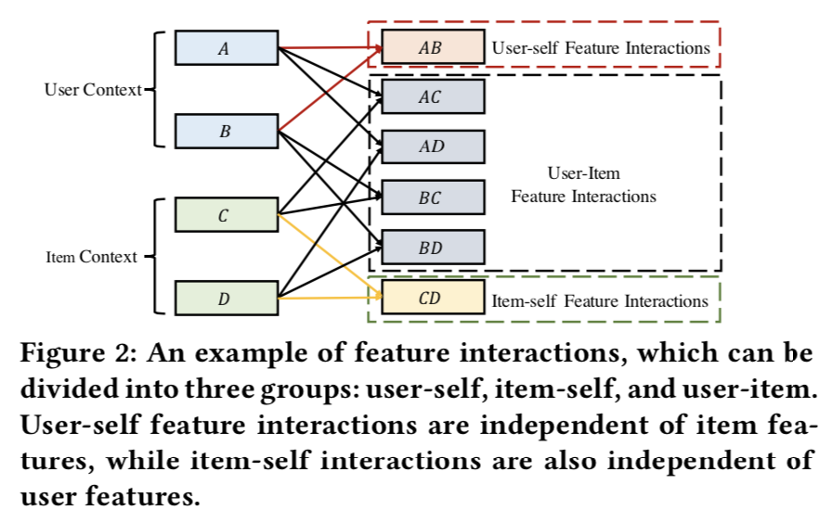
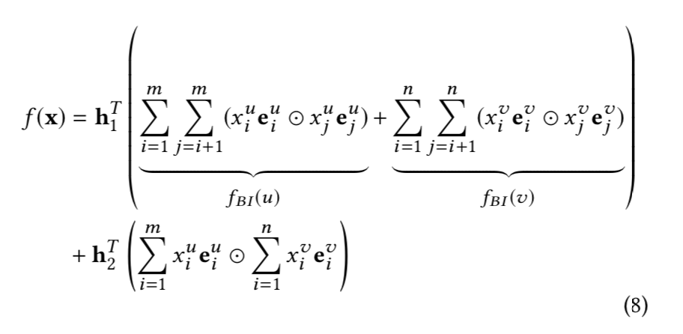
Proof
https://github.com/chenchongthu/ENSFM
https://github.com/THUIR/ENSFM
Notes:
Now we briefly introduce the proof of this theorem, Recall the second-order feature interactions f (x), it can be rearranged to the following equation, which contains user-self feature interaction, item-self feature interaction and user-item feature interaction, as shown in the left figure, user-self feature interactions are independent of item features, and item-self interactions are also independent of user features. Therefore, we could apply memorization strategy to precomputing the two terms.

Slide 11
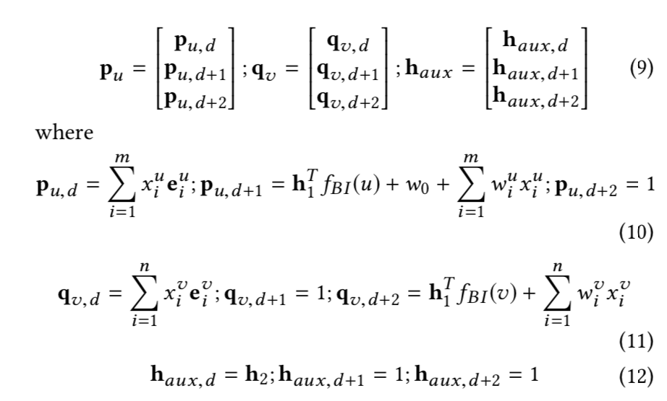
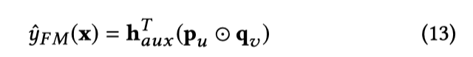
Proof
https://github.com/chenchongthu/ENSFM
https://github.com/THUIR/ENSFM
Notes:
Specifically, we build three auxiliary vectors as follows, As a result, the prediction function of a generalized FM can be reformulated as a matrix factorization function:

Slide 12
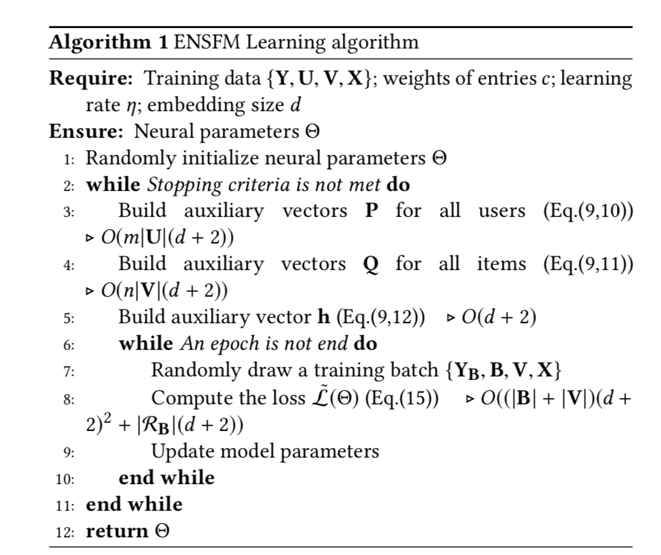
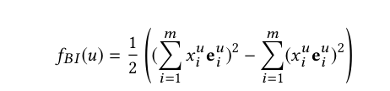
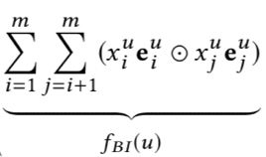
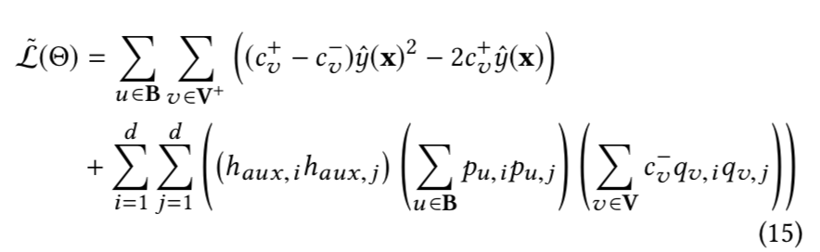
Efficient Mini-batch Learning Algorithm
https://github.com/chenchongthu/ENSFM
https://github.com/THUIR/ENSFM
Notes:
We now introduce our proposed Efficient Mini-batch Learning Algorithm,, which can be derived from the following analysis.
first, user-self feature interaction and item-self feature interactions can be rewritten to achieve linear time complexity
Second, the proof of Theorem \ref{th2} shows that we could achieve a significant speed-up by precomputing the auxiliary vectors to avoid the massive repeated computations.
Finally, after we build the auxiliary vectors, the prediction of our ENSFM is reformulated into a MF function, which satisfies the requirements of THEOREM \ref{th1}. Thus we have the non-sampling loss for a batch of users as follows:

Slide 13
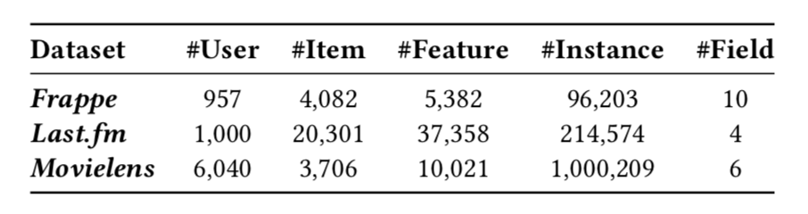
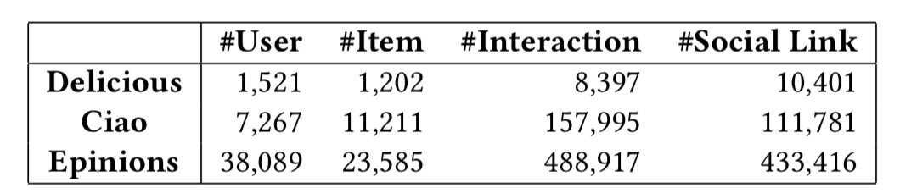
Experimental settings
Datasets:
Baselines:
FM (ICDM 10)
DeepFM (IJCAI 17)
NFM (SIGIR 17)
ONCF (IJCAI 18)
CFM (IJCAI 19)
ENMF (SIGIR 19)
Evaluation methods: HR@K, NDCG@K, K=5, 10, 20
https://github.com/chenchongthu/ENSFM
https://github.com/THUIR/ENSFM
Notes:
Then, in our experiments, we use three public datasets. Which are Frappe, Last.fm,and movlelens. To evaluate the performance, we compared our methods with extensive baselines, including :. The comparison of these methods are shown in this table.
Moreover, we calculate HR and NDCG, which are widely used for evaluating the performance of recommender systems.
Note that for Frappe and Last.fm, we use exactly the same datasets and experimental settings as in the CFM paper.

Slide 14
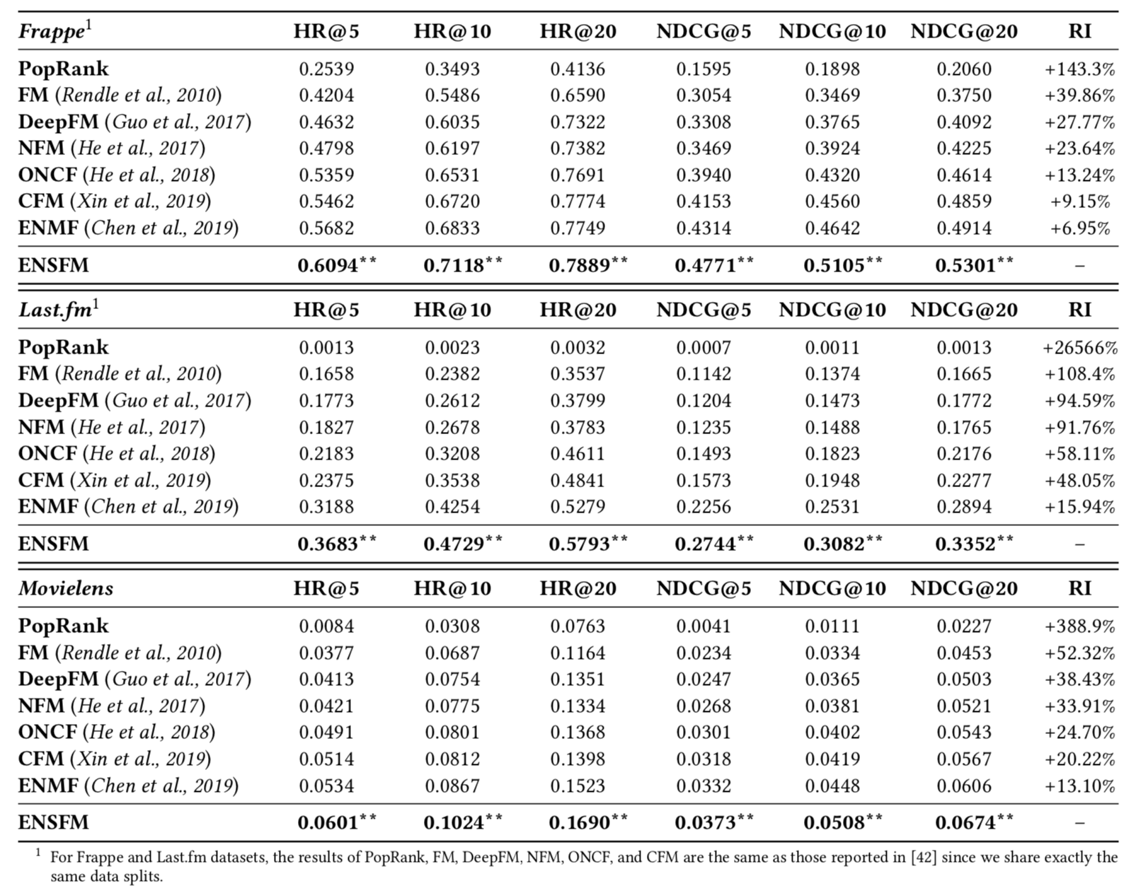
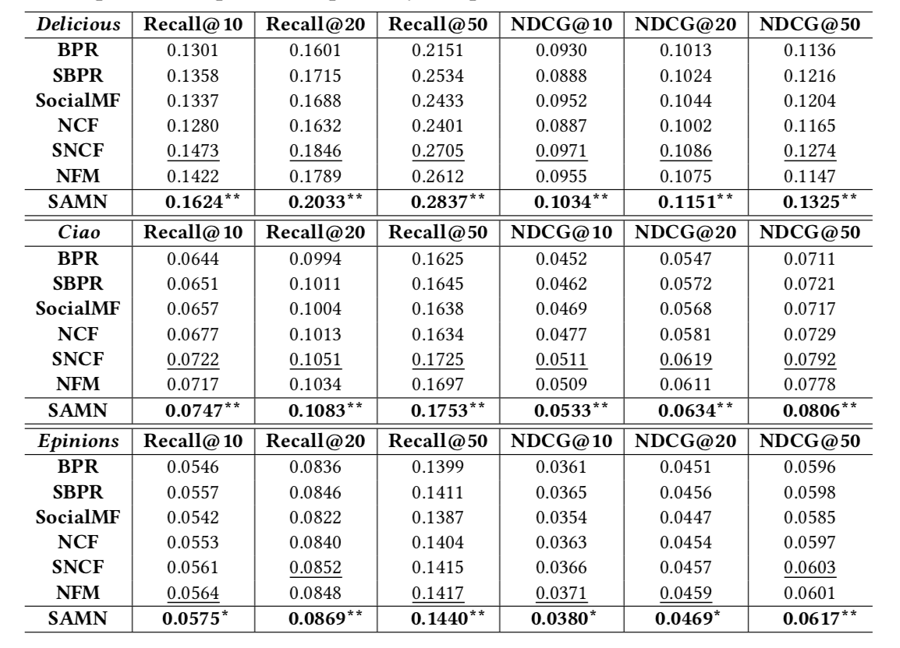
Model Comparisons
Performance comparison on three datasets for all methods
Best Baselines:
ENMF: whole-data
CFM: sampled data
ENSFM
Consistently significantly outperforms the best baseline
Notes:
The Performance comparison on three datasets for all methods are shown in this table。
From the table, we can see that.
First and foremost, our proposed ENSFM achieves the best performance on the three datasets, significantly outperforming all the state-of-the-art baseline methods.
Specifically, compared to CFM --- a recently proposed deep learning-based FM model, our ENSFM shows average improvements of more than 10 % on the three datasets. This is very remarkable, since ENSFM is a shallow FM framework that has much fewer parameters.
The substantial improvement could be attributed to the proposed non-sampling learning algorithm. The parameters in ENSFM is optimized on the whole data, while sample-based methods (FM, DeepFM, NFM, ONCF, CFM) only use a fraction of sampled data and may ignore important negative examples.
Second,
Although deep learning-based FM methods do achieve better performance than original FM when adopting the same sampling-based learning strategy, the improvements are relatively small compared with our non-sampling ENSFM. It reveals that on ranking tasks, deeper models do not necessarily lead to optimal results. A better learning strategy is even more important than advanced neural network structures. The large performance gap between baselines and our ENSFM reflects the value of learning FM without sampling for ranking tasks.

Slide 15
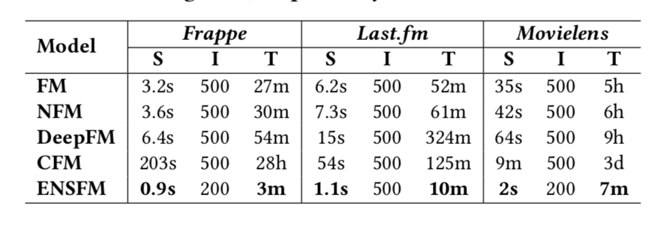
Model Analysis -1 : Efficiency Analysis
Comparison of runtime
s:second; m: minute; h: hour; d: day
S: training time for a single iteration;
I: Overall iterations;
T: Total time
Notes:
Moreover.
Many deep learning studies only focused on obtaining better results but ignore the computational efficiency of reaching the reported accuracy \cite{schwartz2019green}. However, expensive training cost can limit the applicability of a model to real-world large-scale systems. In this section, we conducted experiments to explore the training efficiencies of our ENSFM and four state-of-the-art FM methods: FM, DeepFM, NFM, and CFM. All experiments are run on the same machine for fair comparison on the efficiency.
We first investigated the training time of FM, DeepFM, NFM, CFM and our ENSFM with different embedding size $d$. The results are shown in Figure \ref{figure4}. From the figure, we can see that the training time cost of ENSFM is much less than other FM methods with different size of $d$. As $d$ increases, the costs of baseline methods increase significantly, while our ENSFM still maintain a very fast training process (e.g., 2 seconds per iteration on Movielens with a large $d$ of 64). We then compared the overall training time of the above methods. The embedding size is set to 64 for all the methods and the results are shown in Table \ref{table4}. We can obviously observe that the overall training time of our ENSFM is \textbf{several magnitudes faster} than the baseline models. In particular, for the largest dataset Movielens, our ENSFM only needs 7 minutes to achieve the optimal performance, while the state-of-the-art models NFM, DeepFM, and CFM take about 6 hours, 9 hours, and 3 days, respectively. This acceleration is over 50 times than NFM and 600 times than CFM, which is highly valuable in practice and is difficult to achieve with simply engineering efforts. For other datasets, the results of ENSFM are also remarkable. In real E-commerce scenarios, the cost of training time is also an important factor to be considered \cite{chen2019efficient}. Our ENSFM shows significant advantages in training efficiency, which makes it more practical in real~life.

Slide 16
Model Analysis - 2: Hyper-parameter
Notes:
It is also worth mention that our ENSFM can be tuned very easily in practice, because The overall training process of ENSFM is very fast and Generally only one specific parameter --- negative weight $c_0$ needs to be tuned for different datasets.
The above figure shows the performance with respect to the embedding size $d$. As can be seen from this figure, our ENSFM outperforms all the other models with different values of $d$. Notably, ENSFM with embedding size of 32 even performs better than the state-of-the-art method CFM with a larger embedding size of 64.
We also show the results of our ENSFM with different negative weights in the bottom Figure. Considering the performance on each dataset, we find that the optimal weight of missing instance depends on the density of the dataset. Also, we can see that our ENSFM is very robust to the value of $c_0$. Generally, ENSFM outperforms the best baseline CFM with a wide range of $c_0$ on the three datasets (e.g., $c_0$ between 0.1 to 1 on Movielens).

Slide 17
Conclusion
We highlight the importance of learning FM without sampling for ranking tasks, which is more effective and stable due to the consideration of all samples in each parameter update
We present a novel embedding-based ENSFM framework. It complements the mainstream sampling-based context-aware models and provides an efficient, effective, and theoretical guaranteed solution to improve FM.
The model consistently outperforms the state-of-the-art recommendation methods on both accuracy and efficiency.
Effective non-sampling optimization
Efficient model training
Good performance
Notes:
And finally, let me make a brief conclusion. In this work, We highlight the importance of learning FM without sampling for ranking tasks, which is more effective and stable due to the consideration of all samples in each parameter update
We then
. And experiment results show that our method

Slide 18
Discussion
Recently, there is a surge of interest in applying novel neural networks for recommendation tasks.
More complex models do not necessarily lead to better results since they are more difficult to optimize and tune
We empirically shows that a proper learning method is even more important than advanced neural network structures
we expect future research should focus more on designing models with better learning algorithms for specific tasks, rather than relying on complex models and expensive computational power for minor improvements
Notes:
We also want to make some discussions about the recently studies on recommendation. Recently, there is a surge of interest in applying novel neural networks for recommendation tasks. However, more complex models do not always lead to better results since they are more dicult to optimize and tune [6]. Our work empirically shows that a proper learning method is even more important than advanced neural network structures. As such, we expect future research should pay more attention to design models with better learning algorithms for specific tasks, rather than relying on complex models and expensive computational power for minor improvements

Slide 19
Thank You!
z-m@tsinghua.edu.cn
cc17@mails.tsinghua.edu.cn
https://github.com/chenchongthu/ENSFM
https://github.com/THUIR/ENSFM
Notes:
That’ all. Thank you
If you are interested in this work or have any questions, please …
Think you!

